Slide 1
Projet Reinforcement Learning
LACHAUSSEE QUENTIN
14-01-2022
Notes:
Bonjour à tous et à toute, déjà merci d'être présent pour ma soutenance,
Donc je m'appelle Quentin LACHAUSSEE, je viens d'un DUT Statistiques et informatique décisionnelle
Et aujourd'hui je travaille en tant qu’alternant chez MESEA depuis près d'un an et demi maintenant
Et aujourd'hui je vais vous parler de mon entreprise et comment mon projet a pu améliorer les conditions de travail de mes collègues.
Donc, dites-moi,
Est-ce que vous saviez que vous pouviez faire le trajet entre Tours et Bordeaux en moins d'une 1 heure?
Et bien ça, c'est possible en train ! grâce à la ligne à grande vitesse SEA,
Mais pour en arriver à cette prouesse au niveau national, il y a toute une histoire derrière, des points positifs comme des points négatifs à améliorer, un véritable background.

Slide 2
Sommaire
I- Développement du 1er jeu
II- Q-Learning
III- Affichage des résultats
IV- Gagner en efficacité
V- Développement du 2ème jeu
VI- Conclusion
VII- Deep Q-Learning
Notes:
So, about my company, in 2008, the French railway network launched a call for the construction of a new high-speed line between Tours and Bordeaux.
----------------------------
In 2011, the company LISEA took part in this concession contract for a period of 50 years.
----------------------------
Then, LISEA confided the design and construction of the LGV to the group COSEA, C like Constructor.
----------------------------
Since the end of the construction in July 2017, the group MESEA is responsible of the maintenance, M like Maintenance, of this LGV of the South Europe Atlantic.
----------------------------
So, MESEA is the private part of a public-private partnership with the SNCF, it has 3 maintenance bases in Clérac, Villognon, Nouâtre and one secondary base in Poitiers to ensure the safe running of trains 24/7.

Slide 3
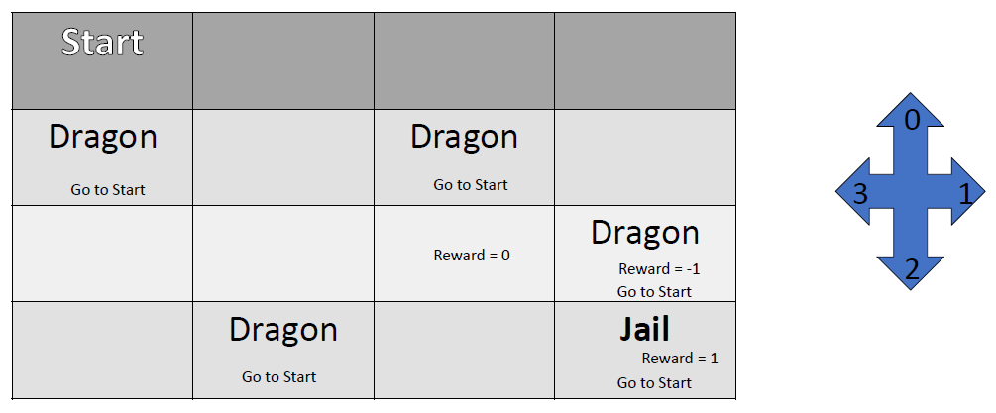
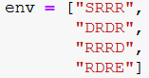
I – Développement du 1er jeu - Environnement
Le plateau de jeu étant configuré de cette manière :
Je l’ai recréé sous forme de liste
où 1 valeur correspond à 1 ligne :
S : correspond à « Start » (Début de partie)
D : correspond à « Dragon » (Obstacle)
R : correspond à « Rien » (Case vide)
E : correspond à « End » (Fin de partie)
Notes:
Today, MESEA has around 200 employees, which can be divided into an operational and a functional branch.
The functional part concerns the production support activities, such as the Industrial Department, the Performance Department, the Quality, Safety and Environment Department etc.
----------------------------
The operational part is responsible of the line maintain, covering all the areas of a high-speed line.
In the world of railway maintenance, there are many different areas but we can reduce them to 4 major sectors: The track, the switch, the signalling and the energy.
The railway tracking is a runway for the trains. A train cannot driving on the road, that’s why the track allows to give a trajectory and a stability to the train.
The railway switching allows to give a direction to the train, to direct it, on one track or another.
The railway signalling can be defined as all the systems designed to control the train traffic in safety.

Slide 4
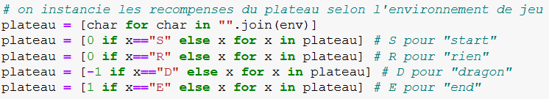
I – Développement du 1er jeu - Récompense
Avec l’environnement de jeu sous forme de liste de 4 valeurs pour les 4 lignes :
Ensuite on va attribuer à chaque case une récompense selon sa valeur :
On va tout séparer pour avoir un plateau de jeu ou chaque valeur correspond à 1 case :
Pour rappel :
S : correspond à « Start » (Début de partie)
D : correspond à « Dragon » (Obstacle)
R : correspond à « Rien » (Case vide)
E : correspond à « End » (Fin de partie)
Notes:
Today, MESEA has around 200 employees, which can be divided into an operational and a functional branch.
The functional part concerns the production support activities, such as the Industrial Department, the Performance Department, the Quality, Safety and Environment Department etc.
----------------------------
The operational part is responsible of the line maintain, covering all the areas of a high-speed line.
In the world of railway maintenance, there are many different areas but we can reduce them to 4 major sectors: The track, the switch, the signalling and the energy.
The railway tracking is a runway for the trains. A train cannot driving on the road, that’s why the track allows to give a trajectory and a stability to the train.
The railway switching allows to give a direction to the train, to direct it, on one track or another.
The railway signalling can be defined as all the systems designed to control the train traffic in safety.

Slide 5
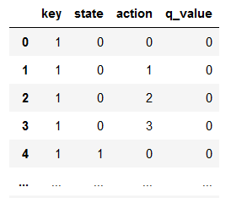
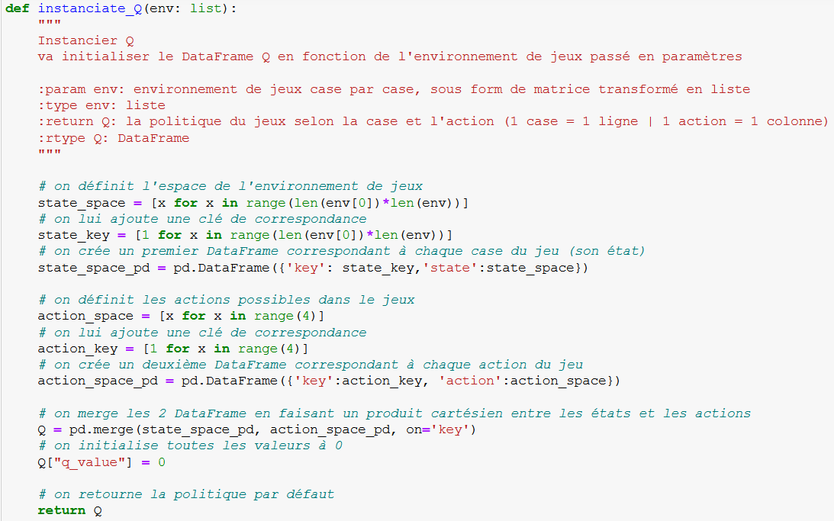
I – Développement du 1er jeu – Politique d’action
Pour la politique d’action, j’ai utilisé la librairie « pandas » pour me faire un DataFrame :
« State » correspond à la case de l’environnement
« Action » correspond au mouvement avec :
0 : le joueur se déplace en haut
1 : le joueur se déplace à droite
2 : le joueur se déplace en bas
3 : le joueur se déplace à gauche
« Q_value » correspond à la politique d’action
(dépendra des récompenses obtenues)
Notes:
Today, MESEA has around 200 employees, which can be divided into an operational and a functional branch.
The functional part concerns the production support activities, such as the Industrial Department, the Performance Department, the Quality, Safety and Environment Department etc.
----------------------------
The operational part is responsible of the line maintain, covering all the areas of a high-speed line.
In the world of railway maintenance, there are many different areas but we can reduce them to 4 major sectors: The track, the switch, the signalling and the energy.
The railway tracking is a runway for the trains. A train cannot driving on the road, that’s why the track allows to give a trajectory and a stability to the train.
The railway switching allows to give a direction to the train, to direct it, on one track or another.
The railway signalling can be defined as all the systems designed to control the train traffic in safety.

Slide 6
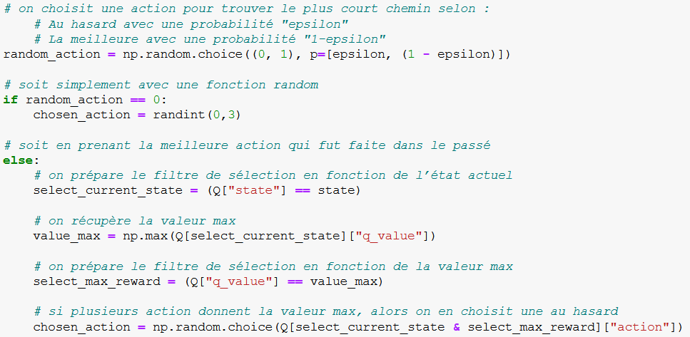
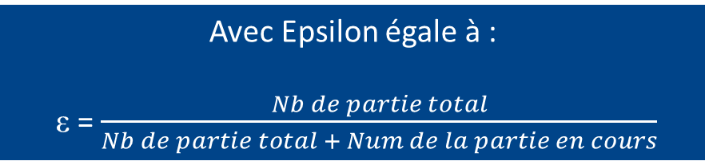
II – Q-Learning – Choix d’une action
Pour que l’algorithme fasse le choix d’une action, j’ai utilisé la librairie « numpy » pour faire un « random.choice » (« choix aléatoire ») entre :
Exploration, selon la probabilité « Epsilon » -> un choix aléatoire entre les 4 actions
Exploitation, selon la probabilité « 1 - Epsilon » -> utiliser la meilleur politique d’action
Avec Epsilon égale à :
ε = $\frac{Nb de partie total}{Nb de partie total + Num de la partie en cours}$
Notes:
Today, MESEA has around 200 employees, which can be divided into an operational and a functional branch.
The functional part concerns the production support activities, such as the Industrial Department, the Performance Department, the Quality, Safety and Environment Department etc.
----------------------------
The operational part is responsible of the line maintain, covering all the areas of a high-speed line.
In the world of railway maintenance, there are many different areas but we can reduce them to 4 major sectors: The track, the switch, the signalling and the energy.
The railway tracking is a runway for the trains. A train cannot driving on the road, that’s why the track allows to give a trajectory and a stability to the train.
The railway switching allows to give a direction to the train, to direct it, on one track or another.
The railway signalling can be defined as all the systems designed to control the train traffic in safety.

Slide 7
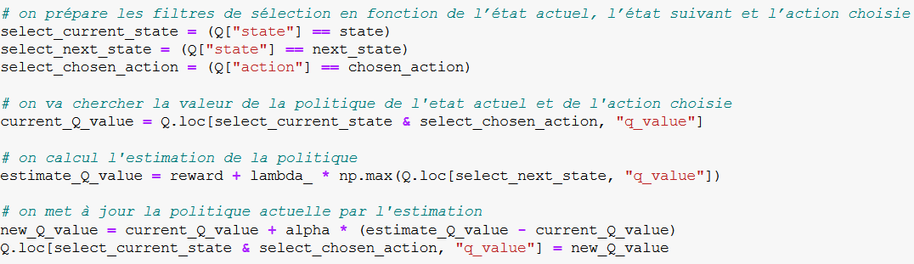
II – Q-Learning – Résultat de la nouvelle politique
Pour obtenir le résultat de la nouvelle politique, j’ai utilisé cette formule :
La politique est désormais modifiée vers le + ou le - selon si la partie était bonne ou mauvaise.
Notes:
Today, MESEA has around 200 employees, which can be divided into an operational and a functional branch.
The functional part concerns the production support activities, such as the Industrial Department, the Performance Department, the Quality, Safety and Environment Department etc.
----------------------------
The operational part is responsible of the line maintain, covering all the areas of a high-speed line.
In the world of railway maintenance, there are many different areas but we can reduce them to 4 major sectors: The track, the switch, the signalling and the energy.
The railway tracking is a runway for the trains. A train cannot driving on the road, that’s why the track allows to give a trajectory and a stability to the train.
The railway switching allows to give a direction to the train, to direct it, on one track or another.
The railway signalling can be defined as all the systems designed to control the train traffic in safety.

Slide 8
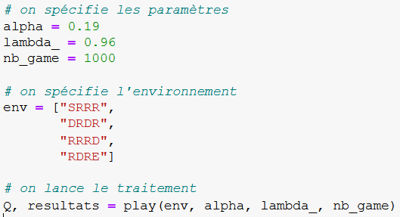
II – Q-Learning – Lancement de l’apprentissage
Pour un 1er test, j’ai initialisé les paramètres comme suit et j’ai appelé ma fonction « play » qui va lancer l’apprentissage de l’algorithme et me retourner 2 DataFrames :
Q : Ma politique d’action finale
Resultats : Le détails de mes parties
Notes:
Today, MESEA has around 200 employees, which can be divided into an operational and a functional branch.
The functional part concerns the production support activities, such as the Industrial Department, the Performance Department, the Quality, Safety and Environment Department etc.
----------------------------
The operational part is responsible of the line maintain, covering all the areas of a high-speed line.
In the world of railway maintenance, there are many different areas but we can reduce them to 4 major sectors: The track, the switch, the signalling and the energy.
The railway tracking is a runway for the trains. A train cannot driving on the road, that’s why the track allows to give a trajectory and a stability to the train.
The railway switching allows to give a direction to the train, to direct it, on one track or another.
The railway signalling can be defined as all the systems designed to control the train traffic in safety.

Slide 9
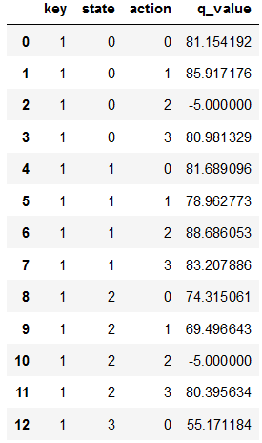
III – Affichage des résultats – Politique d’action
Dans « Q » on y retrouve la politique d’action finale :
0
4
1
0
1
2
3
2
4
Avec les valeurs dans l’encadré rouge, on comprends que dans la case 0, il ne faut surtout pas descendre (action 2) pour ne pas avoir une récompense négative (signifiant une défaite)
Notes:
Today, MESEA has around 200 employees, which can be divided into an operational and a functional branch.
The functional part concerns the production support activities, such as the Industrial Department, the Performance Department, the Quality, Safety and Environment Department etc.
----------------------------
The operational part is responsible of the line maintain, covering all the areas of a high-speed line.
In the world of railway maintenance, there are many different areas but we can reduce them to 4 major sectors: The track, the switch, the signalling and the energy.
The railway tracking is a runway for the trains. A train cannot driving on the road, that’s why the track allows to give a trajectory and a stability to the train.
The railway switching allows to give a direction to the train, to direct it, on one track or another.
The railway signalling can be defined as all the systems designed to control the train traffic in safety.

Slide 10
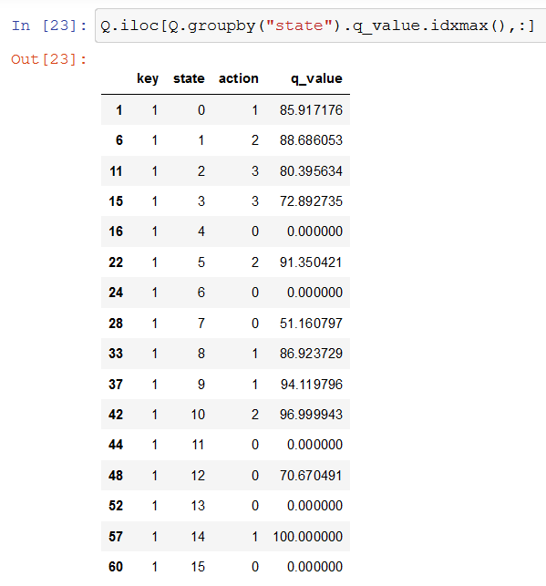
III – Affichage des résultats – Politique d’action
On peut exécuter cette ligne de code pour avoir les meilleures action à faire selon la case :
0
4
1
0
1
2
3
2
4
5
9
10
14
Avec les valeurs dans les encadrés rouge, on comprends que :
Dans la case 0, il faut aller à droite -> Puis -> Dans la case 1, il faut aller en bas
Et ainsi de suite jusqu’à se retrouver dans la case 14 et aller à droite pour arriver à la case finale sans encombre
Notes:
Today, MESEA has around 200 employees, which can be divided into an operational and a functional branch.
The functional part concerns the production support activities, such as the Industrial Department, the Performance Department, the Quality, Safety and Environment Department etc.
----------------------------
The operational part is responsible of the line maintain, covering all the areas of a high-speed line.
In the world of railway maintenance, there are many different areas but we can reduce them to 4 major sectors: The track, the switch, the signalling and the energy.
The railway tracking is a runway for the trains. A train cannot driving on the road, that’s why the track allows to give a trajectory and a stability to the train.
The railway switching allows to give a direction to the train, to direct it, on one track or another.
The railway signalling can be defined as all the systems designed to control the train traffic in safety.

Slide 11
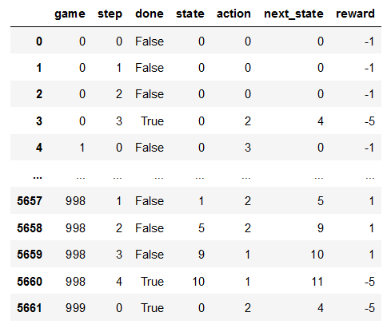
III – Affichage des résultats – Details des parties
Dans « résultats » on y retrouve le détails des déplacements des 1000 parties :
Avec en description de chaque déplacement :
« state » : son état
« action » : l’action qu’il a prévu de faire
Et donc :
« next_state » : son prochain état
« reward » : la récompense qui en découle
PS : « done » expose si son prochain coup amènera à une fin de partie (tomber sur un dragon ou trouver le joyau) ou non respectivement par « True » ou « False »
Notes:
Today, MESEA has around 200 employees, which can be divided into an operational and a functional branch.
The functional part concerns the production support activities, such as the Industrial Department, the Performance Department, the Quality, Safety and Environment Department etc.
----------------------------
The operational part is responsible of the line maintain, covering all the areas of a high-speed line.
In the world of railway maintenance, there are many different areas but we can reduce them to 4 major sectors: The track, the switch, the signalling and the energy.
The railway tracking is a runway for the trains. A train cannot driving on the road, that’s why the track allows to give a trajectory and a stability to the train.
The railway switching allows to give a direction to the train, to direct it, on one track or another.
The railway signalling can be defined as all the systems designed to control the train traffic in safety.

Slide 12
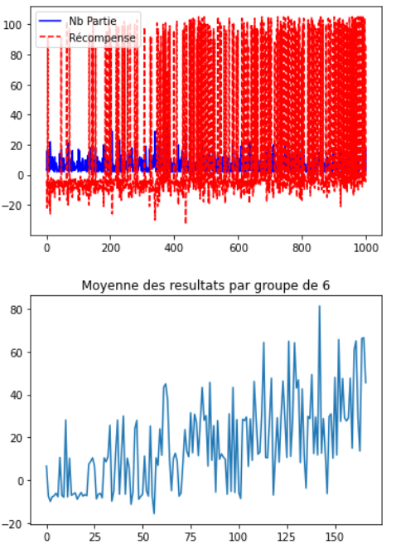
III – Affichage des résultats – Courbe
A l’aide des résultats on peut afficher des courbes pour suivre le nombre de partie réussi selon leurs récompenses :
Plus le rouge est dominant,
Plus on peut avoir confiance en la politique de décision
Plus la courbe monte,
Plus l’algorithme exploite la politique de décision qu’il considère comme efficace
Notes:
Today, MESEA has around 200 employees, which can be divided into an operational and a functional branch.
The functional part concerns the production support activities, such as the Industrial Department, the Performance Department, the Quality, Safety and Environment Department etc.
----------------------------
The operational part is responsible of the line maintain, covering all the areas of a high-speed line.
In the world of railway maintenance, there are many different areas but we can reduce them to 4 major sectors: The track, the switch, the signalling and the energy.
The railway tracking is a runway for the trains. A train cannot driving on the road, that’s why the track allows to give a trajectory and a stability to the train.
The railway switching allows to give a direction to the train, to direct it, on one track or another.
The railway signalling can be defined as all the systems designed to control the train traffic in safety.

Slide 13
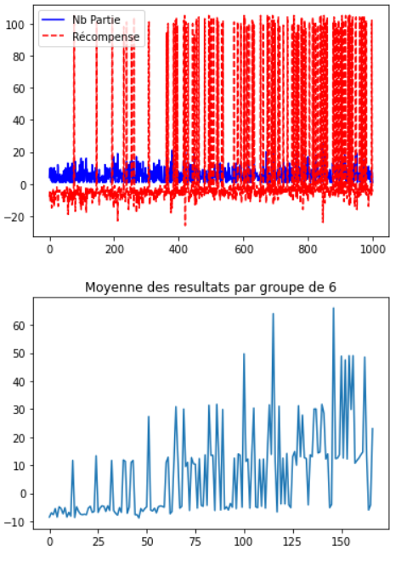
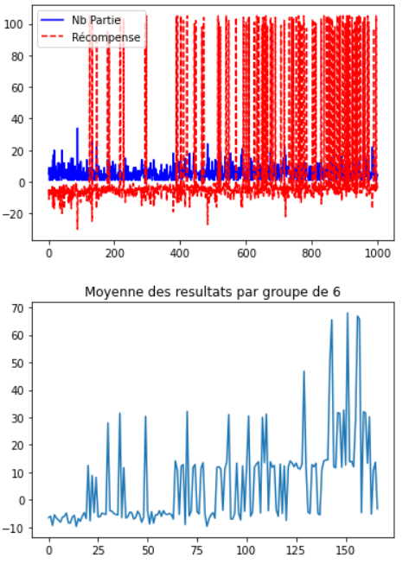
IV – Gagner en efficacité – Modifier les récompenses
Après modification des récompenses, les résultats n’étaient pas significativement différents :
Test 1 :
D = -1
R = 0
E = 100
Test 2 :
D = -5
R = 1
E = 100
Test 3 :
D = -1
R = 1
E = 100
Les résultats me semblaient très liés à la chance lors du choix aléatoire des actions au début des parties.
Notes:
Today, MESEA has around 200 employees, which can be divided into an operational and a functional branch.
The functional part concerns the production support activities, such as the Industrial Department, the Performance Department, the Quality, Safety and Environment Department etc.
----------------------------
The operational part is responsible of the line maintain, covering all the areas of a high-speed line.
In the world of railway maintenance, there are many different areas but we can reduce them to 4 major sectors: The track, the switch, the signalling and the energy.
The railway tracking is a runway for the trains. A train cannot driving on the road, that’s why the track allows to give a trajectory and a stability to the train.
The railway switching allows to give a direction to the train, to direct it, on one track or another.
The railway signalling can be defined as all the systems designed to control the train traffic in safety.

Slide 14
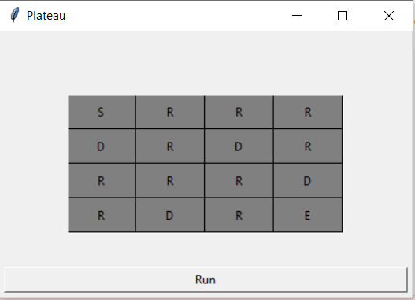
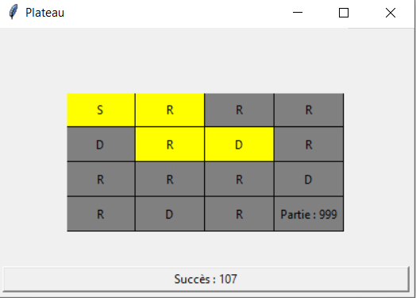
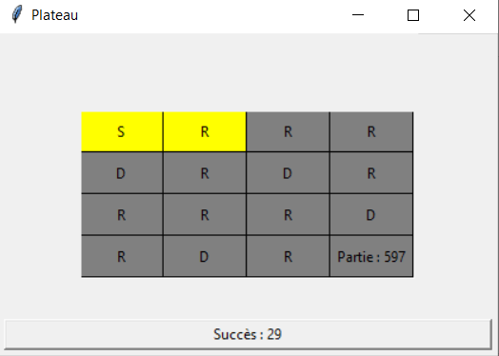
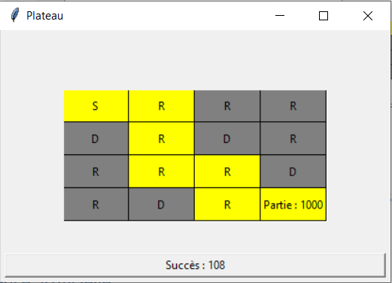
IV – Gagner en efficacité – Suivre l’apprentissage
Pour suivre l’apprentissage, j’ai utilisé la librairie « tkinter » pour me faire une fenêtre interactive qui pourrait m’afficher toutes les parties effectuées ainsi que tous leurs déplacements :
Et en suivant les parties, cela m’a conforté dans l’idée que les résultats me semblaient très liés à la chance lors du choix aléatoire des actions au début des parties.
C’est pourquoi j’ai eu l’idée d’augmenter la taille du plateau pour mieux comprendre le comportement de notre intelligence artificielle.
Notes:
Today, MESEA has around 200 employees, which can be divided into an operational and a functional branch.
The functional part concerns the production support activities, such as the Industrial Department, the Performance Department, the Quality, Safety and Environment Department etc.
----------------------------
The operational part is responsible of the line maintain, covering all the areas of a high-speed line.
In the world of railway maintenance, there are many different areas but we can reduce them to 4 major sectors: The track, the switch, the signalling and the energy.
The railway tracking is a runway for the trains. A train cannot driving on the road, that’s why the track allows to give a trajectory and a stability to the train.
The railway switching allows to give a direction to the train, to direct it, on one track or another.
The railway signalling can be defined as all the systems designed to control the train traffic in safety.

Slide 15
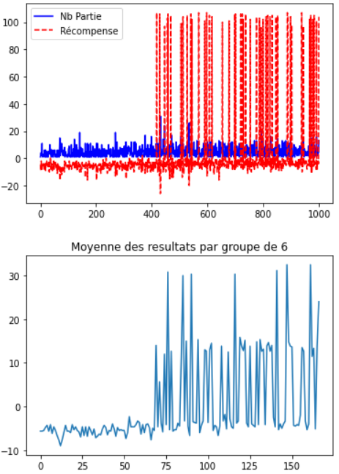
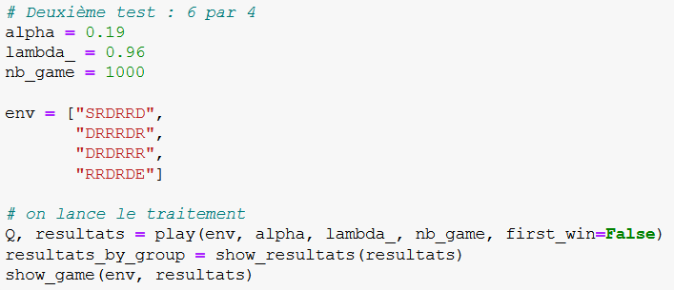
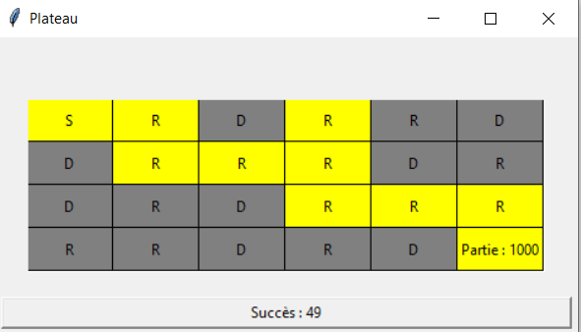
V – Développement du 2ème Jeu – Environnement 6 par 4
J’ai commencer par faire un plateau de 6 colonnes pour 4 lignes :
Les résultats étaient plutôt bon dès le 1er test,
Mais avant de changer les récompenses ou les paramètres,
Je me suis dis : « pourquoi ne pas directement viser plus haut ? »…
Notes:
Today, MESEA has around 200 employees, which can be divided into an operational and a functional branch.
The functional part concerns the production support activities, such as the Industrial Department, the Performance Department, the Quality, Safety and Environment Department etc.
----------------------------
The operational part is responsible of the line maintain, covering all the areas of a high-speed line.
In the world of railway maintenance, there are many different areas but we can reduce them to 4 major sectors: The track, the switch, the signalling and the energy.
The railway tracking is a runway for the trains. A train cannot driving on the road, that’s why the track allows to give a trajectory and a stability to the train.
The railway switching allows to give a direction to the train, to direct it, on one track or another.
The railway signalling can be defined as all the systems designed to control the train traffic in safety.

Slide 16
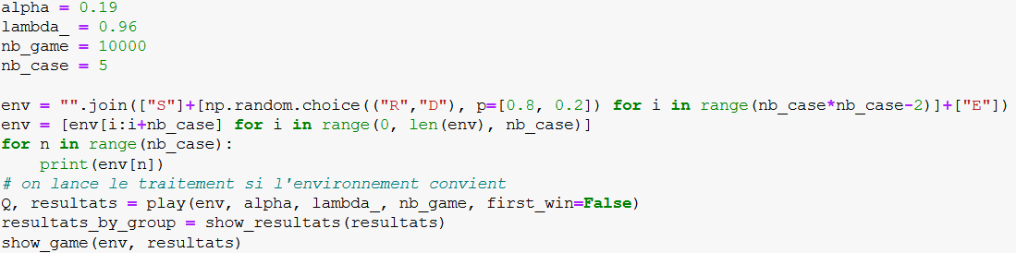
V – Développement du 2ème Jeu – Environnement aléatoire
J’ai donc instauré un nouveau paramètre « nb_case » qui va me permettre de générer des plateaux de jeux carrés avec « nb_case » lignes et « nb_case » colonnes :
Les cases « Start » et « End » seront forcément respectivement en haut à gauche et en bas à droite.
Les autres cases seront remplies aléatoirement avec une probabilité de 80% d’être vides, et 20% d’avoir un dragon.
L’environnement est affiché avant de lancer l’apprentissage pour que l’utilisateur s’assure que le niveau est possible (le joyau est atteignable).
Notes:
Today, MESEA has around 200 employees, which can be divided into an operational and a functional branch.
The functional part concerns the production support activities, such as the Industrial Department, the Performance Department, the Quality, Safety and Environment Department etc.
----------------------------
The operational part is responsible of the line maintain, covering all the areas of a high-speed line.
In the world of railway maintenance, there are many different areas but we can reduce them to 4 major sectors: The track, the switch, the signalling and the energy.
The railway tracking is a runway for the trains. A train cannot driving on the road, that’s why the track allows to give a trajectory and a stability to the train.
The railway switching allows to give a direction to the train, to direct it, on one track or another.
The railway signalling can be defined as all the systems designed to control the train traffic in safety.

Slide 17
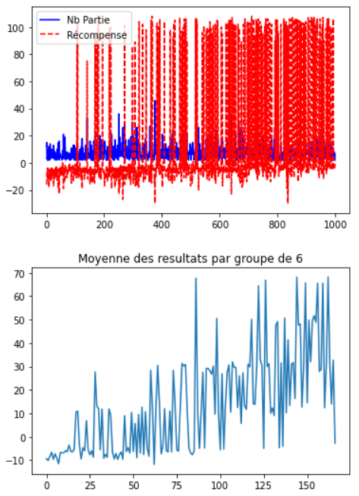
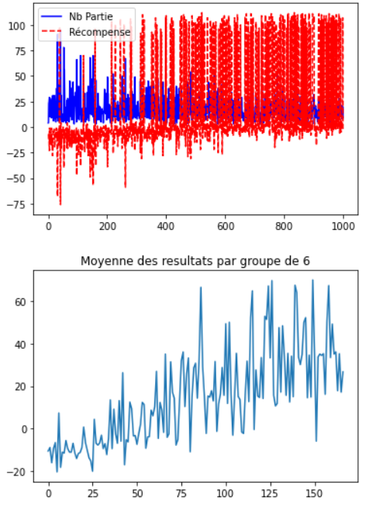
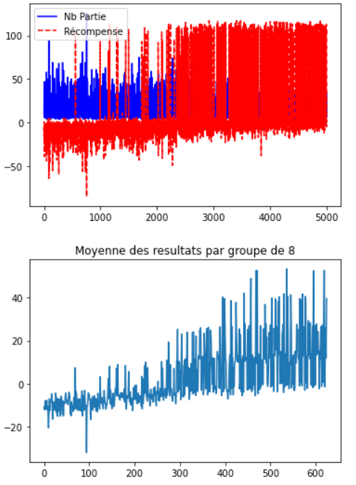
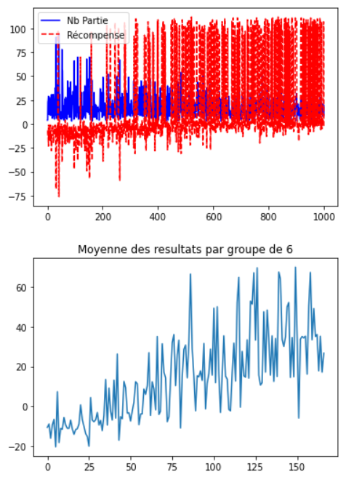
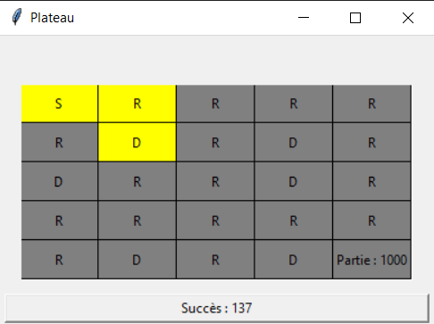
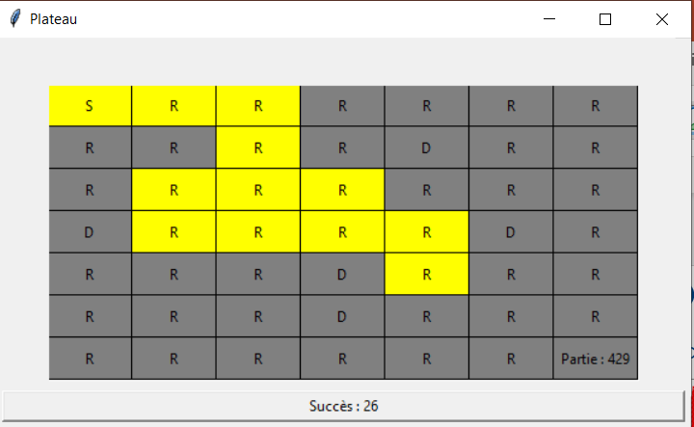
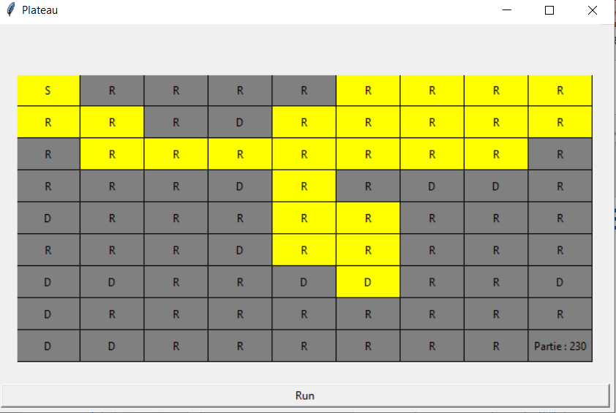
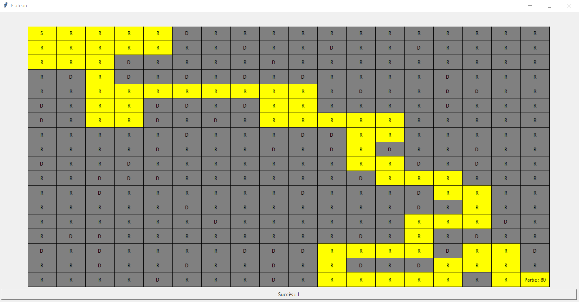
V – Développement du 2ème Jeu – Résultats
Jusqu’à du 18x18
(limite affichable par mon écran) :
J’ai commencé par du 5x5 :
Puis du 7x7 :
Puis du 9x9 :
Notes:
Today, MESEA has around 200 employees, which can be divided into an operational and a functional branch.
The functional part concerns the production support activities, such as the Industrial Department, the Performance Department, the Quality, Safety and Environment Department etc.
----------------------------
The operational part is responsible of the line maintain, covering all the areas of a high-speed line.
In the world of railway maintenance, there are many different areas but we can reduce them to 4 major sectors: The track, the switch, the signalling and the energy.
The railway tracking is a runway for the trains. A train cannot driving on the road, that’s why the track allows to give a trajectory and a stability to the train.
The railway switching allows to give a direction to the train, to direct it, on one track or another.
The railway signalling can be defined as all the systems designed to control the train traffic in safety.

Slide 18
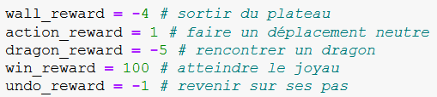
VI – Conclusion
Pour conclure, en augmentant la surface du plateau de jeux j’ai remarqué que les meilleurs résultats apparaissaient selon 3 critères :
Plus la récompense de la case finale est élevée, plus l’apprentissage va suivre le 1er chemin qui lui mène à elle quitte à abandonner l’idée d’identifier le meilleur chemin
Plus la récompense des cases neutres est élevé, plus l’apprentissage va avoir tendance à se balader quitte à oublier le chemin de la victoire
La récompense du dragon ne doit pas être négativement plus forte que la récompense de victoire, pour ne pas annihiler le chemin de la victoire par les nombreux dragons qui l’avoisinent
Mon choix final c’est donc porté sur ces récompenses :
Et elles m’apportent des résultats pleinement satisfaisants
Notes:
Today, MESEA has around 200 employees, which can be divided into an operational and a functional branch.
The functional part concerns the production support activities, such as the Industrial Department, the Performance Department, the Quality, Safety and Environment Department etc.
----------------------------
The operational part is responsible of the line maintain, covering all the areas of a high-speed line.
In the world of railway maintenance, there are many different areas but we can reduce them to 4 major sectors: The track, the switch, the signalling and the energy.
The railway tracking is a runway for the trains. A train cannot driving on the road, that’s why the track allows to give a trajectory and a stability to the train.
The railway switching allows to give a direction to the train, to direct it, on one track or another.
The railway signalling can be defined as all the systems designed to control the train traffic in safety.

Slide 19
VII – Deep Q-Learning
Pour être honnête je n’ai pas du tout réussis à comprendre cette partie Deep Q-Learning.
Le concept est trop compliqué pour moi.
D’autant plus que je n’ai pas réussi à trouver d’aide précises sur Internet qui aurait pu m’aiguiller sur cette partie.
Donc j’espère qu’après avoir corrigé nos devoirs, vous pourriez nous transmettre un corrigé pour que je puisse comprendre cette partie au moins sur la forme, ce serait top !
Notes:
Today, MESEA has around 200 employees, which can be divided into an operational and a functional branch.
The functional part concerns the production support activities, such as the Industrial Department, the Performance Department, the Quality, Safety and Environment Department etc.
----------------------------
The operational part is responsible of the line maintain, covering all the areas of a high-speed line.
In the world of railway maintenance, there are many different areas but we can reduce them to 4 major sectors: The track, the switch, the signalling and the energy.
The railway tracking is a runway for the trains. A train cannot driving on the road, that’s why the track allows to give a trajectory and a stability to the train.
The railway switching allows to give a direction to the train, to direct it, on one track or another.
The railway signalling can be defined as all the systems designed to control the train traffic in safety.

Slide 20
Merci de votre attention
Notes:
les mesures de la tension résiduel des rails qui sont en mVeff

